Slide 1
Introduction to Linear Algebra II
Math Camp 2019
James Steur

Slide 2
Goals of the Session
Review basics of matrices
Understand notation of linear algebra and linear regression
Develop intuition about linear regression (OLS)
Understand assumptions of linear regression (OLS)

Slide 3
Review Matrices (Sanghoon taught you this yesterday and did great!)
The title says it all

Slide 4
What is a matrix?

Slide 5
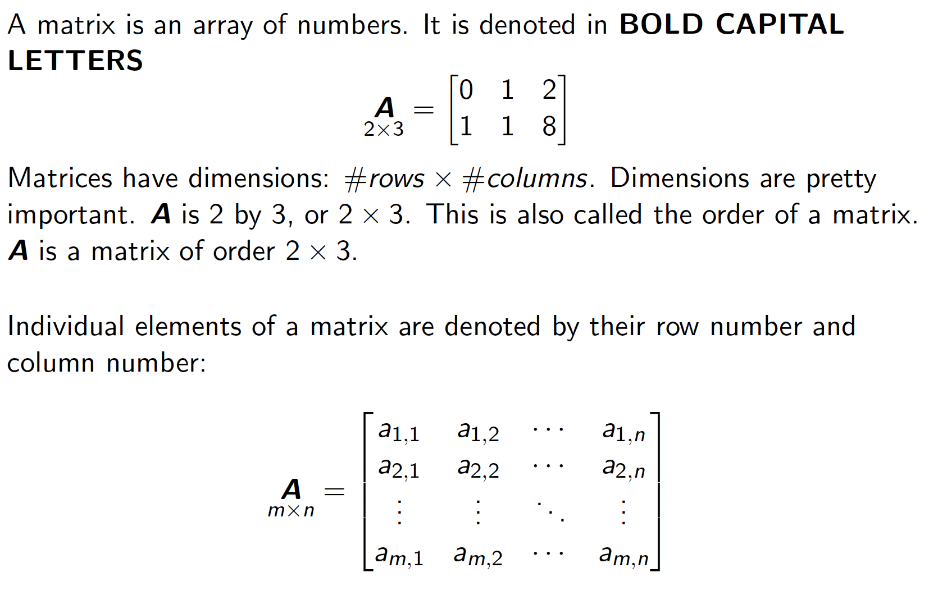
Basics of Matrices: Notation

Slide 6
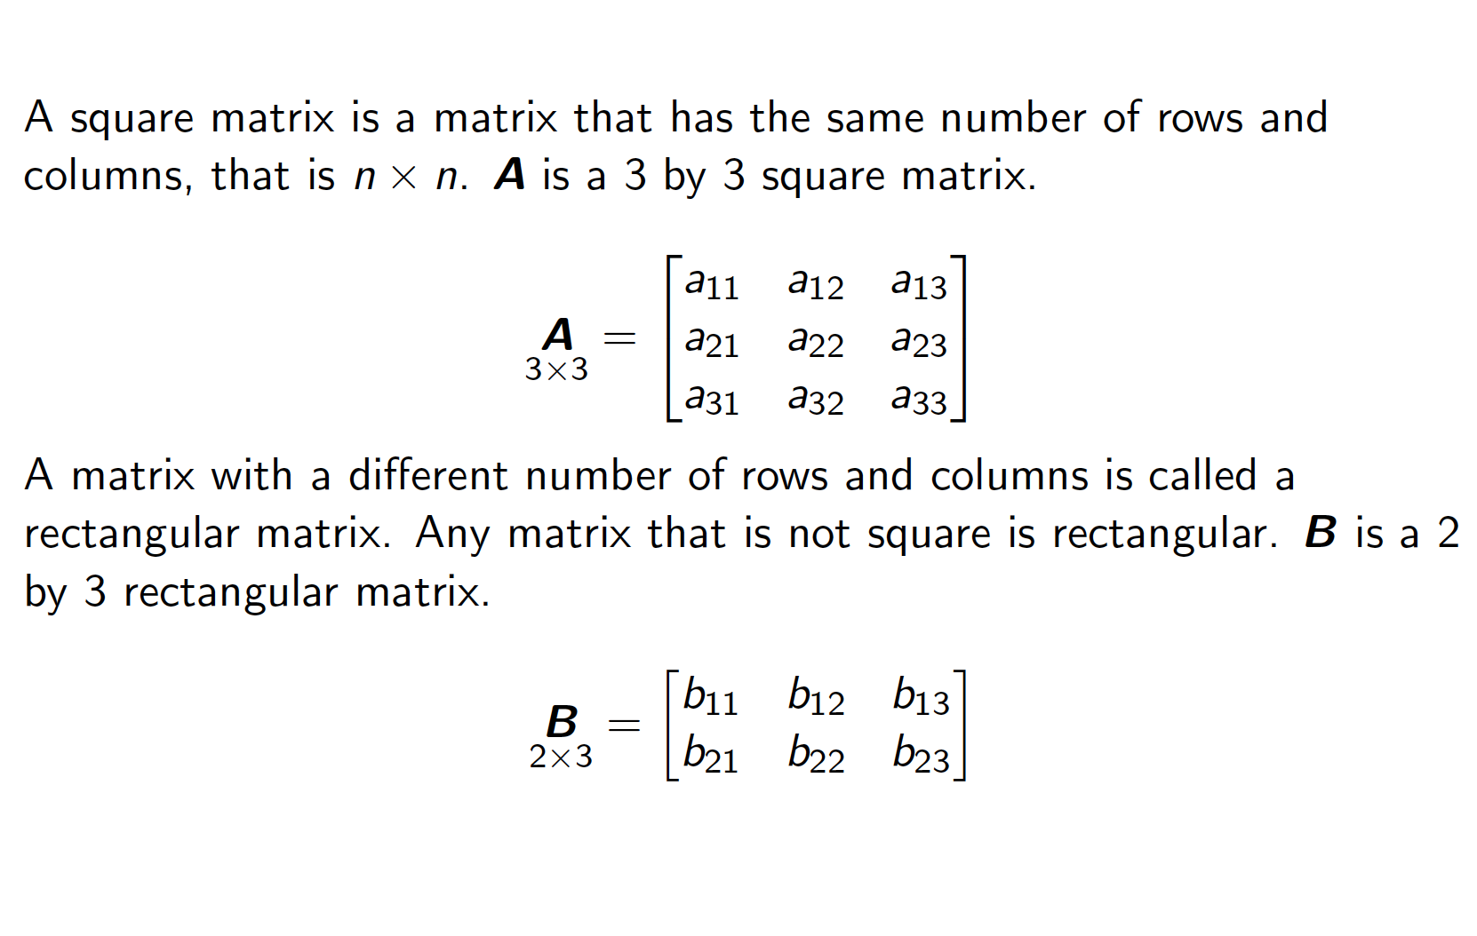
Square & Rectangle

Slide 7
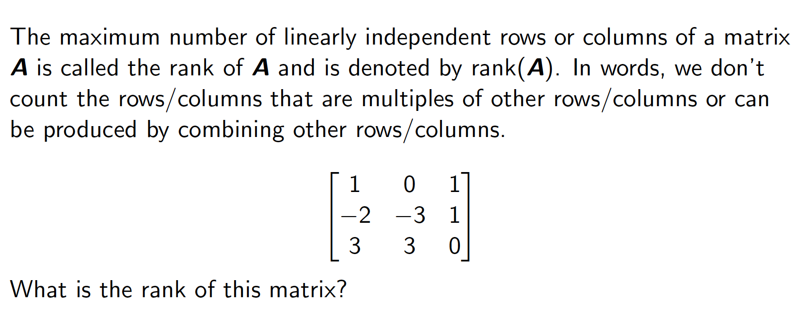
Rank

Slide 8
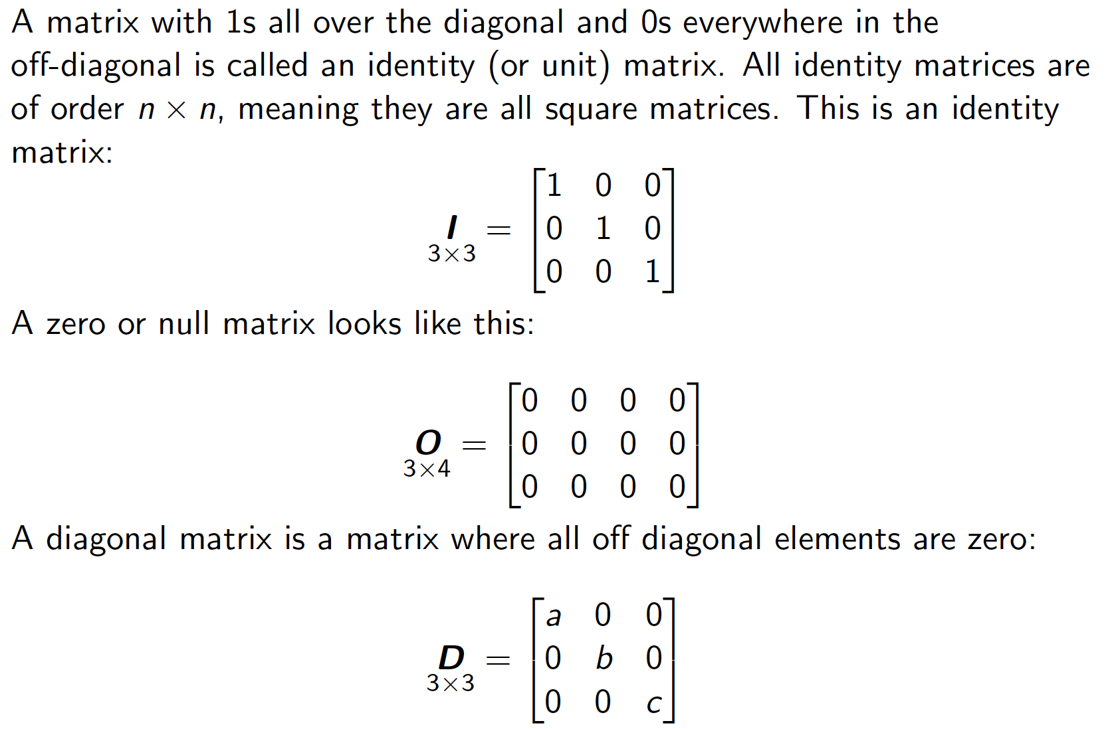
Identity Matrix

Slide 9
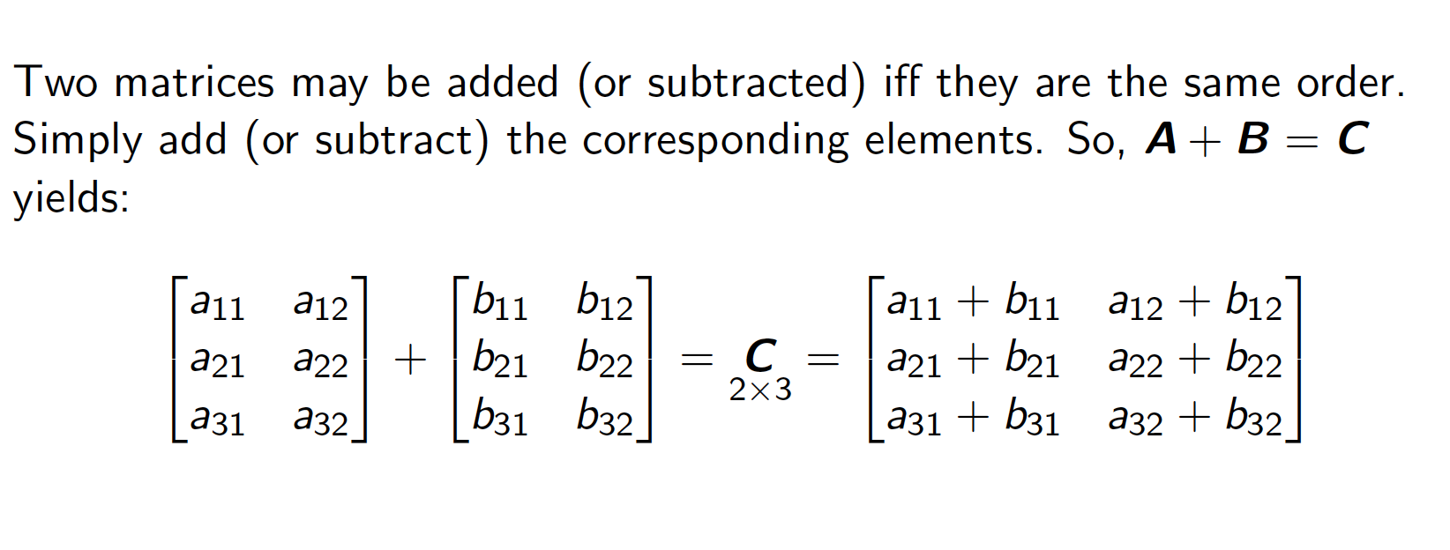
Addition & Subtraction

Slide 10
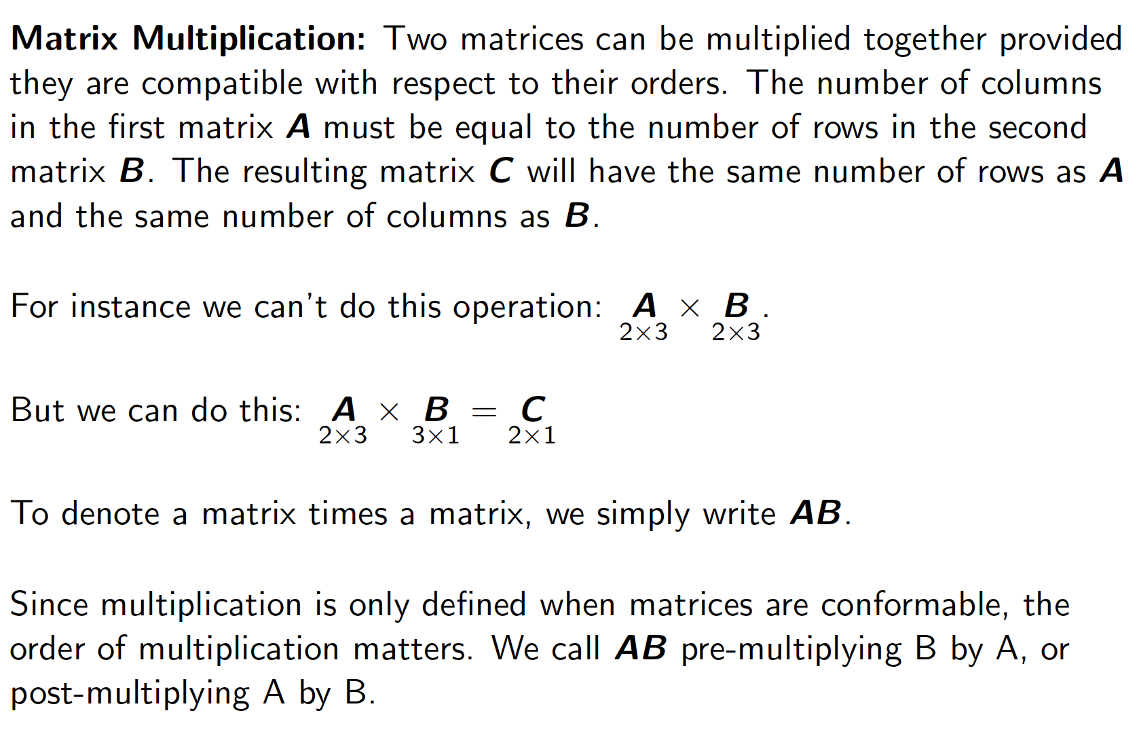
Multiplication

Slide 11
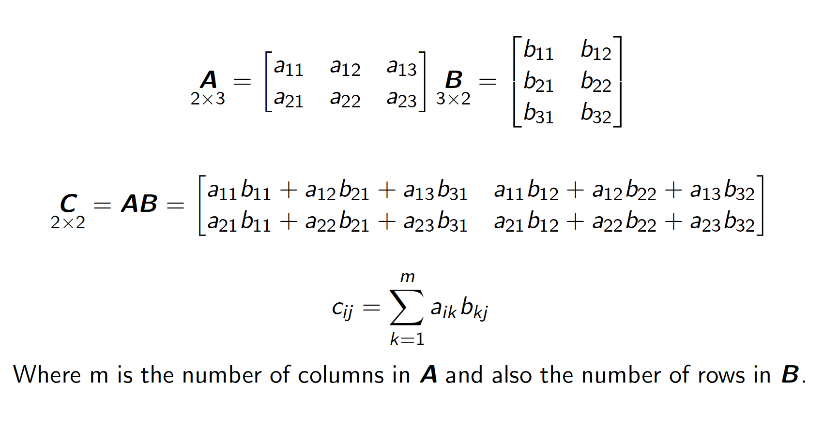
Matrix Multiplication

Slide 12
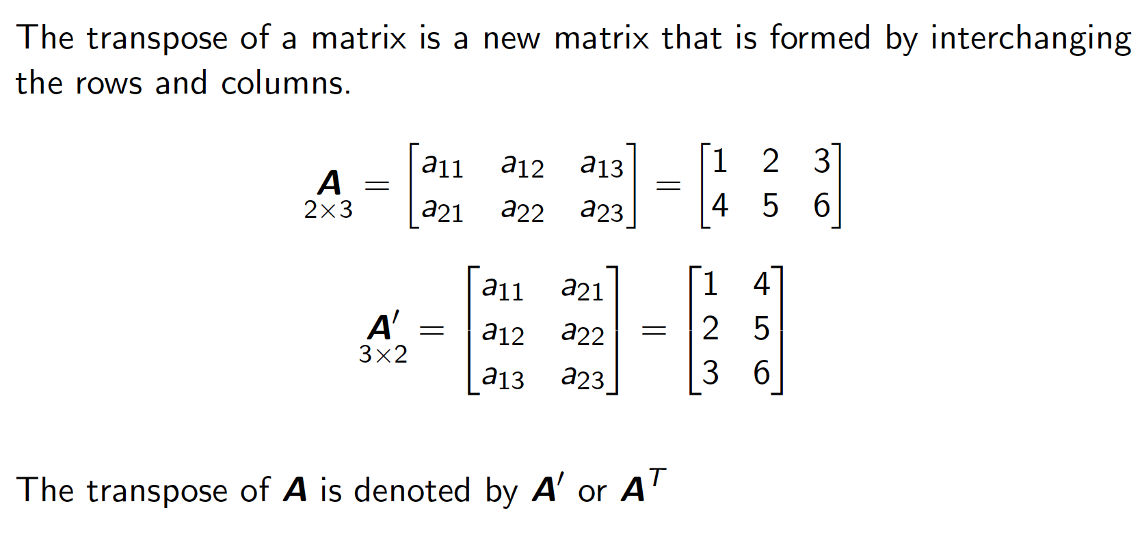
Transposition

Slide 13
What do y’all wanna know about matrices?

Slide 14
Basics of Regression

Slide 15
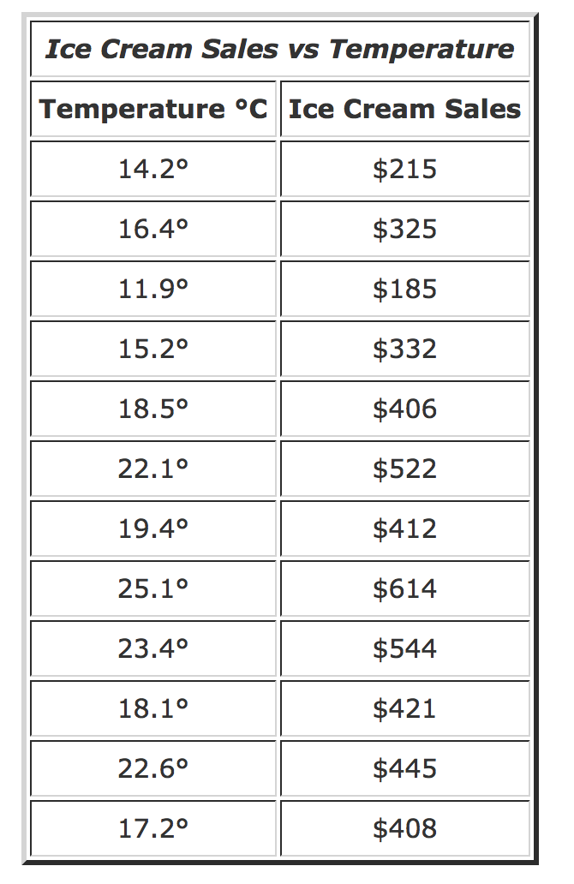
Data

Slide 16
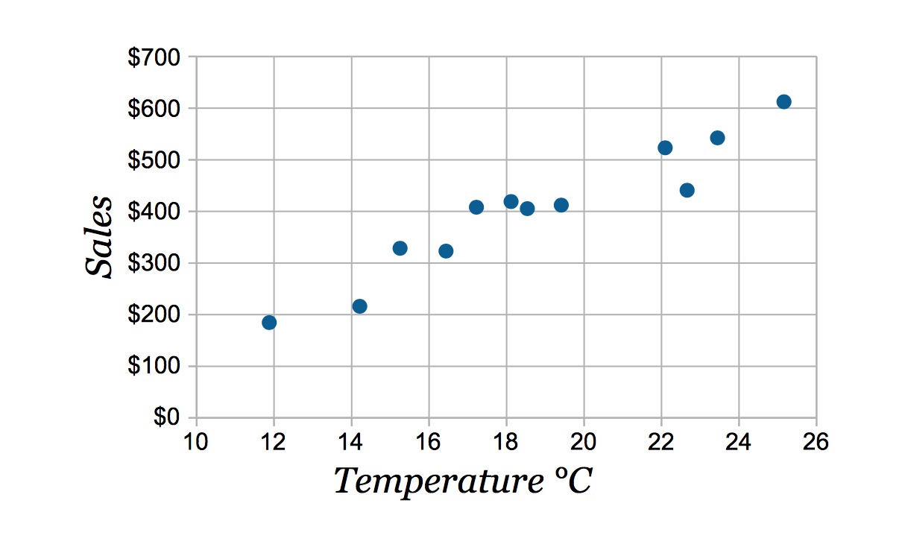
Scatterplot
Ice Cream Sales on Californian Beach in 2017
What is a scatterplot?

Slide 17
How do we represent the relationship between ice cream sales and temperature?
Ice Cream Sales on Californian beach in 2017

Slide 18
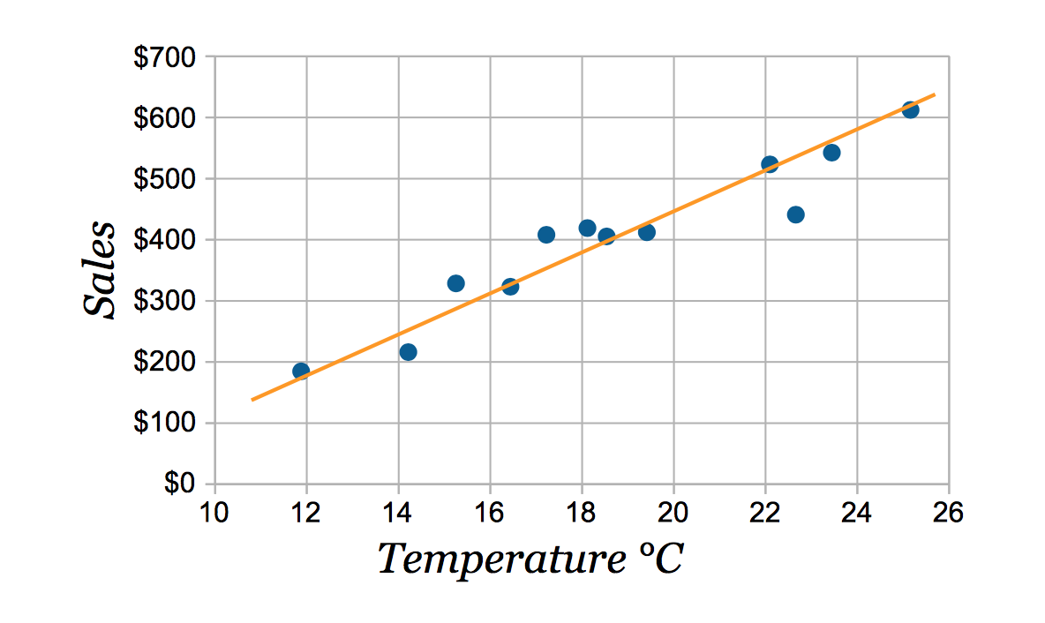
A line

Slide 19
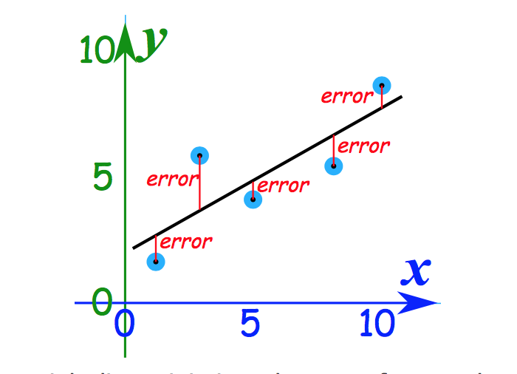

Slide 20
My Claim
To understand data, you “play” with data.
Scatterplots and regression are important to understand data.
Therefore, you need to understand regression.
Why do you agree or disagree with my claim?

Slide 21
Matrices are Great for Representing Data

Slide 22
Think About What Data Tells Us
1). IV: Sex. DV: Liberalness
2). IV: Years of Education. DV: Liberalness

Slide 23
Pop Quiz
What is a scalar?
What is a vector?

Slide 24
Pop Quiz
What is a matrix?
What is rank?

Slide 25
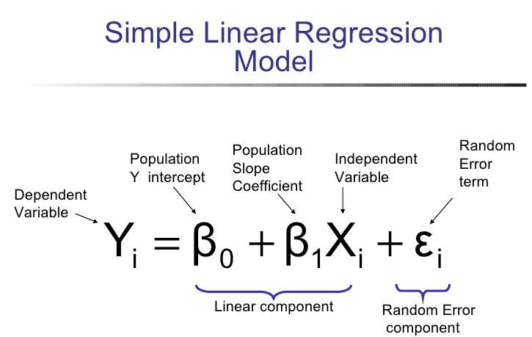
Simple Linear Regression Notation

Slide 27
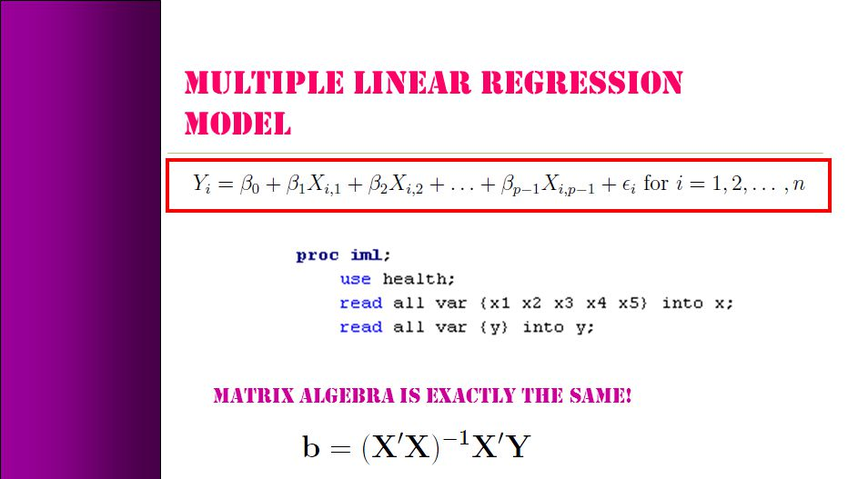
Linear Algebra

Slide 28

Regression Notation
Y = ${\text{β}}_{0}$ + Xβ + ε.
Y=Dependent Variable
${\text{β}}_{0}$=Intercept
X=Independent Variable
Β=Vector of regression coefficients
ε=Error Term

Slide 29

Pop Quiz
We have the following equation: Y = ${\text{β}}_{0}$ + Xβ + ε.
What does “Y” mean?
What does “${\text{β}}_{0}$” mean?
What does “ε” mean?
What does “Xβ” mean?

Slide 30
Assumptions of Regression
Numerical Properties 1. For our OLS algorithm to work, we need variance in X, so var(X) ≠ 0.
2. When we get to multiple regression, we’ll see that we cannot estimate a model with as many or more independent variables than we have data points. We cannot estimate a simple regression with only data point. There are many ways to state this assumption. After we introduce some matrix algebra and think of X as a matrix (with independent variables for columns and observations for rows), we’ll always state it as a restriction about the matrix X.
3. Y and X are linearly related, in particular by the model specification: Y = β0 + β1X + ε

Slide 31
Assumptions of Regression Continued
Statistical Properties
3. The population residuals, ε, are IID, with mean 0 and variance σ2. (Note that this is a statement about random variables, not about sample data)
4a. X is fixed (nonstochastic) and all of our estimates are conditional on X; OR
4b. X is random, and population residuals are independent of X.
4 confuses everyone (at first), and many books make assumption 4a but do not write the conditions explicitly, e.g. E(εi|Xi)=0.

Slide 32
More Assumptions Restated
1. Linear model, Yi = β1+β2Xi + ui 2. X values fixed in repeated sampling 3. Zero mean value of disturbance, E(ui |Xi) = 0 4. Homoscedasticity, var(ui |Xi) = σ2 5. No autocorrelation, cov(ui,uk|Xi,Xk) = 0 6. Cov(ui,Xi) = 0 7. N (observations) > k (parameters) 8. Var(Xi)>0 9. Correct specification 10. No perfect multicollinearity between independent variables

Slide 33
Pop Quiz
What are two assumptions of regression?

Slide 34
Takeaways
Why we care about linear algebra
Intuition & basics behind regression
Assumptions of regression (OLS)
Basics of matrices

Slide 35
References
Mathisfun.org
Gaines, Brian. Matrix Algebra. (Quant I Materials.)
Basar, Ekrem. Matrix Algebra. (Quant II Methods TA Presentation.)
Kim, Sanghoon. Matrix Algebra. (Math Camp Presentation 2019.)

Slide 36
What do y’all wanna know?

Slide 37
If time permits…
Let’s get you doing some addition by hand.

